Slide 1


AUDIT DESK
Academic Audit automation
An application for auditing using JAVA and MySQL

Slide 2
ABSTRACT: ACADEMIC AUDIT AUTOMATION
A cutting-edge system streamlining the audit process in educational institutions. Enhance efficiency, accuracy, and compliance by automating academic audit procedures, ensuring seamless academic quality assurance.

Slide 3


OBJECTIVE
The primary objective is to develop a feature-rich desktop application using Java Swing for the user interface and MySQL for data storage, specifically tailored to meet the auditing requirements of SIT Pune. The application should provide functionalities for recording auditing data, generating reports, managing user accounts, and ensuring data security.

Slide 4
TOOLS USED:
JAVA (JDK 21)
APACHE NETBEANS IDE 21
2. MYSQL (V 8.3.0)
MYSQL WORKBENCH 8.0 CE

Slide 5
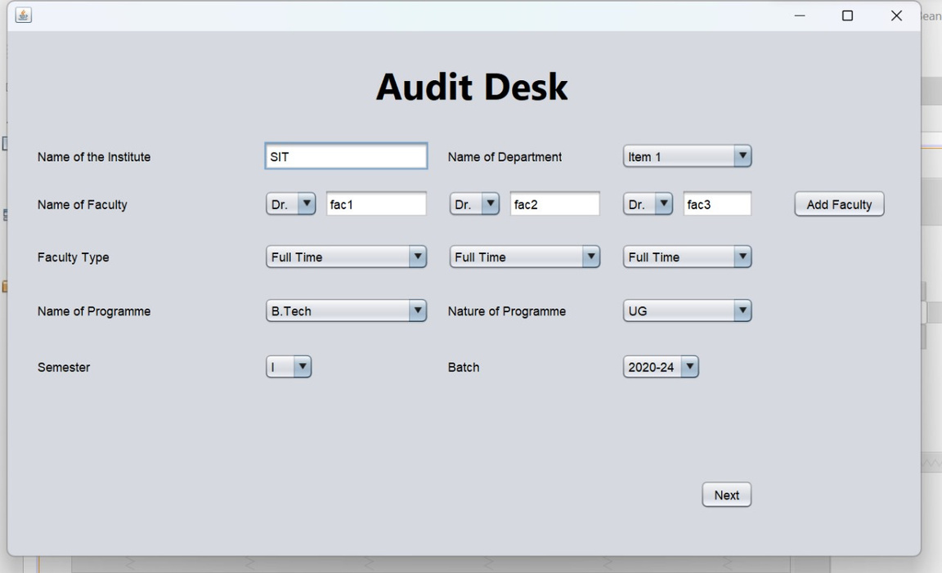
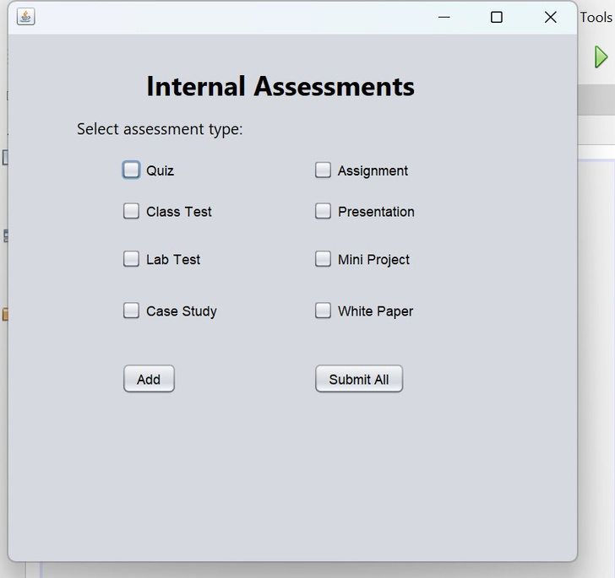
PROGRESS:
JAVA
THIS PAGE TAKES INFORMATION OF FACULTY AS INPUT
FUNCTIONALITY TO ADD ASSESSMENT

Slide 6
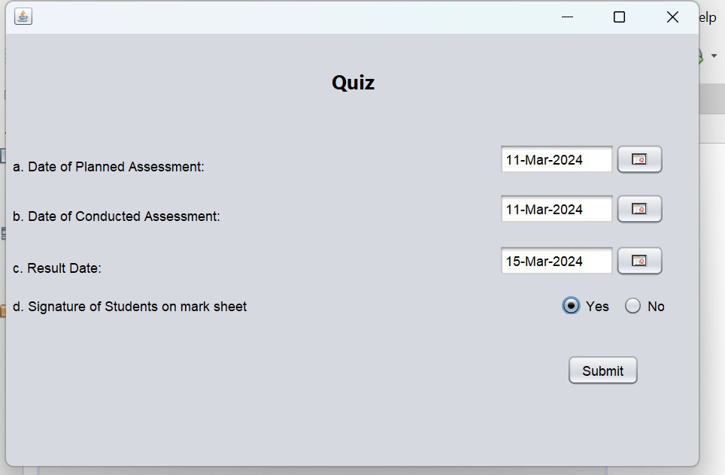
THIS FRAME OPENS WHEN WE SELECT ANY ASSESSMENT AND CLICK THE ADD BUTTON

Slide 7
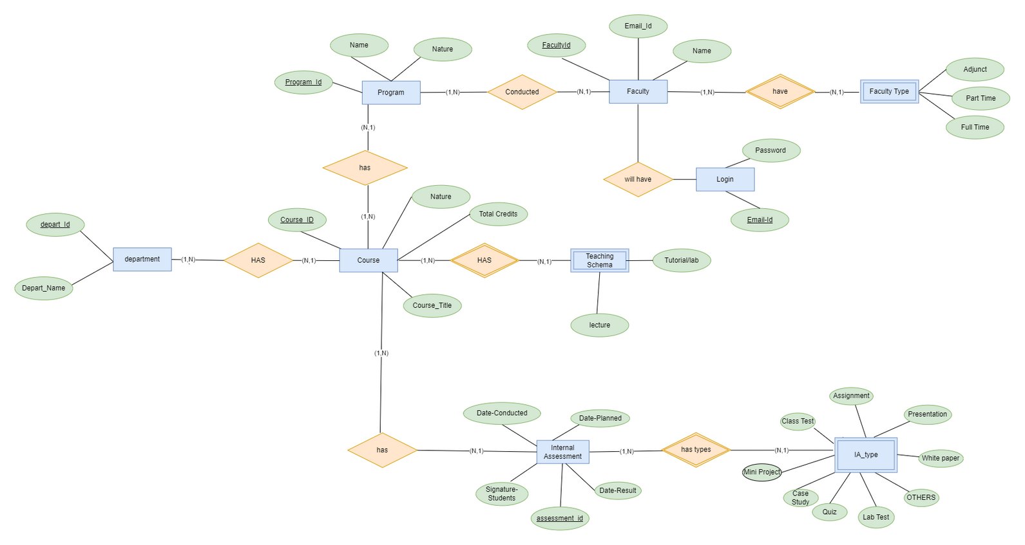
PROGRESS:
BACK-END (MYSQL)

Slide 8






PROJECT DESIGN
APP
FRONT-END
BACK-END
OUTPUT
USER
DATABASE
AUDIT FORM

Slide 9

THANK YOU

Slide 10
TEAM MEMBERS
JAY GONDALIYA 22070122088
K RISHIK KUMAR REDDY 22070122091
DHAIRYA MEHRA 22070122118
RUTU BHANDERI 22070122168

